Slide 1
Lecture 3 Describing and Visualizing Distributions Continued

Slide 2
Review
A natural first step of statistical description is to look graphical summaries of the observations for our variables
A distribution of a variable gives (a) the values that occur and (b) how often each value occurs
A frequency table is a tabular descriptions of the distribution of a variable – it can be applied to either quantitative or qualitative variables

Slide 3
Graphical Descriptions Of Data
Qualitative Variable
Quantitative Variable
Bar graph
Pie Chart
Pareto Chart
Dot Plot
Stem Chart
Histogram
Describe Key features of the Distribution
Modal Category
Shape
Center
Spread

Slide 4
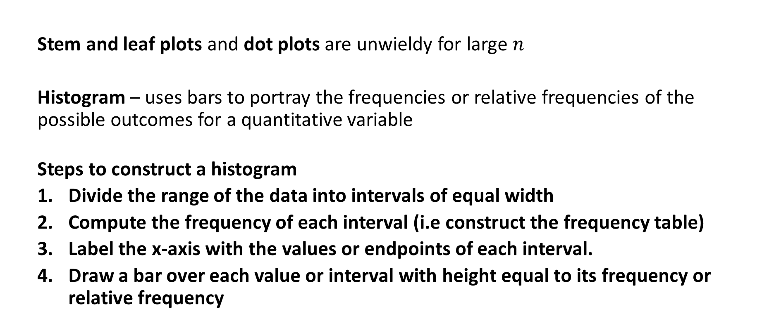
Visualizing Distributions: Quantitative Variables
Stem and leaf plots and dot plots are unwieldy for large $n$
Histogram – uses bars to portray the frequencies or relative frequencies of the possible outcomes for a quantitative variable
Steps to construct a histogram
Divide the range of the data into intervals of equal width
Compute the frequency of each interval (i.e construct the frequency table)
Label the x-axis with the values or endpoints of each interval.
Draw a bar over each value or interval with height equal to its frequency or relative frequency

Slide 5
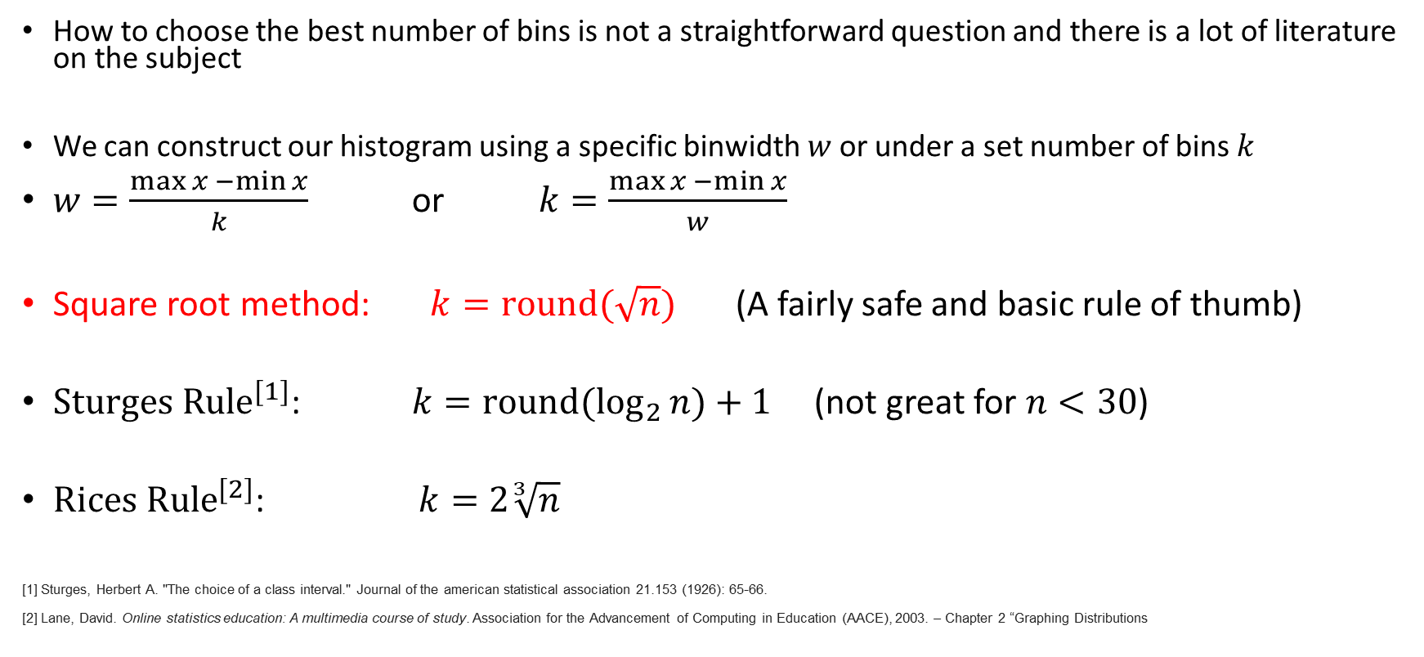
How to choose the number of Bins?
How to choose the best number of bins is not a straightforward question and there is a lot of literature on the subject
We can construct our histogram using a specific binwidth $w$ or under a set number of bins $k$
$w=\frac{\max{x −\min{x}}}{k}$ or $k=\frac{\max{x −\min{x}}}{w}$
Square root method: $k=round(\sqrt{n})$ (A fairly safe and basic rule of thumb)
${Sturges Rule}^{[1]}$: $k={round(log}_{2}{n)+1 }$ (not great for $n<30$)
${Rices Rule}^{[2]}$: $k=2\sqrt[3]{n}$
[1] Sturges, Herbert A. "The choice of a class interval." Journal of the american statistical association 21.153 (1926): 65-66.
[2] Lane, David. Online statistics education: A multimedia course of study. Association for the Advancement of Computing in Education (AACE), 2003. – Chapter 2 “Graphing Distributions

Slide 6
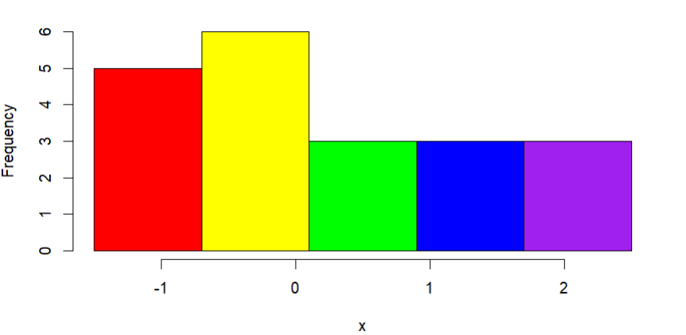
Try it out: Histogram
Consider the following $n=20$ observations of a continuous variable
Bin 1
Bin 2
Bin 3
Bin 4
Bin 5
x = -1.5, -1.2, -1.0, -0.8, -0.7, -0.6, -0.1, -0.1, 0.1, 0.1, 0.1, 0.6, 0.6, 0.8, 1.1, 1.2, 1.3, 1.8, 1.9, 2.4

Slide 7
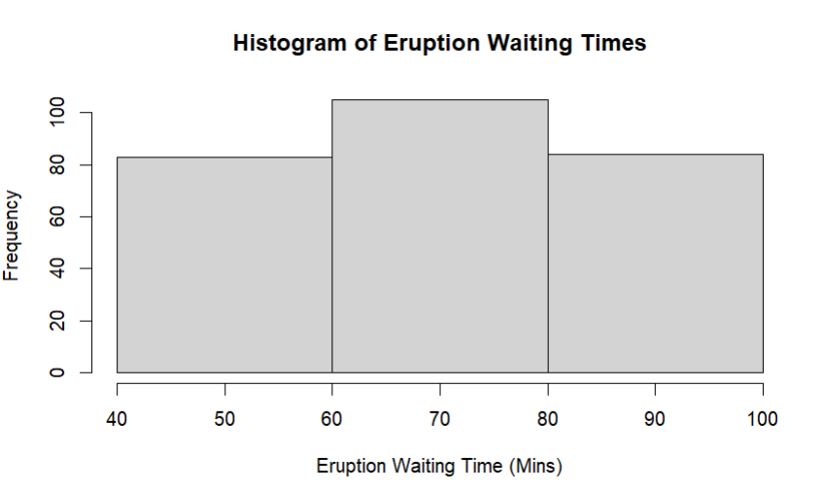
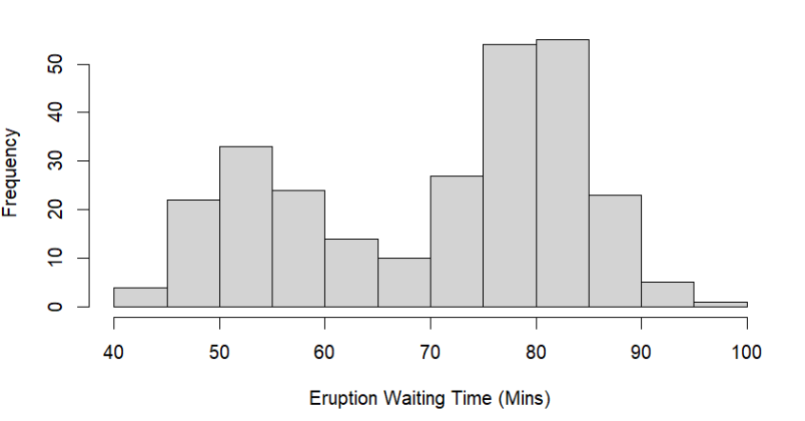
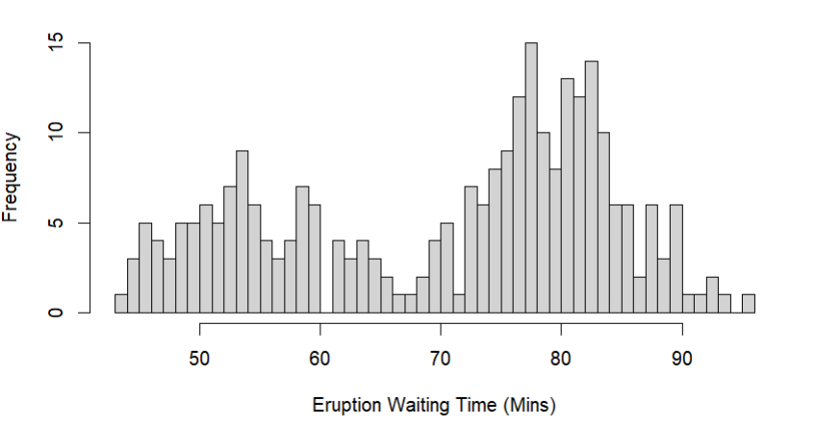
Some tips
If too few intervals are used, then the graph will be too crude
If too many intervals are used, graph will contain many short bars and gaps.
Usually between 5 - 15 intervals are enough.
Most plotting software will automatically choose the number of bins.
ALWAYS plot the histogram to get an idea about the shape of the distribution of a quantitative variable
Is the number of observations is small (say n < 50) then it’s a good idea to supplement a histogram with a dot plot or stem plot

Slide 8
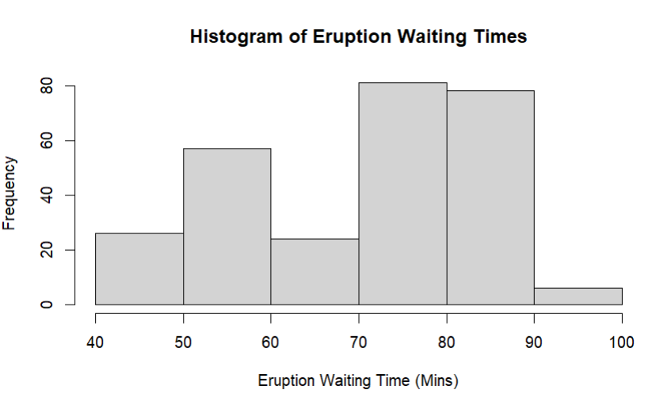
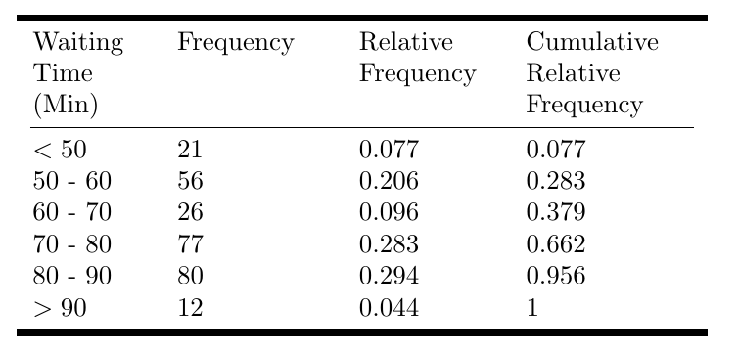
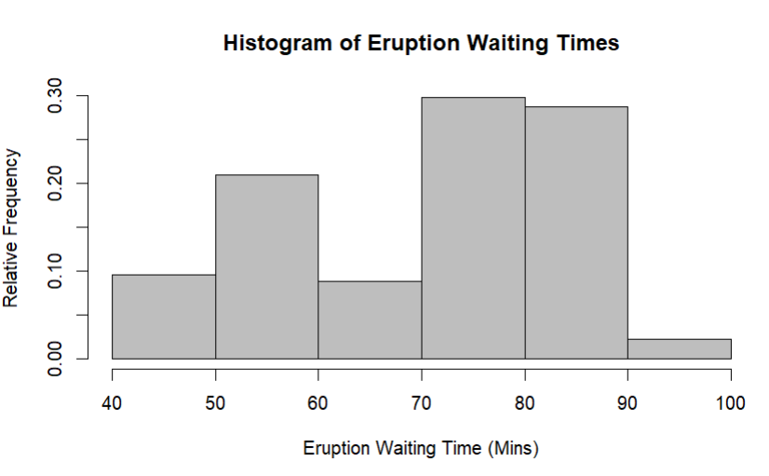
Example: Old Faithful Eruption Times

Slide 9
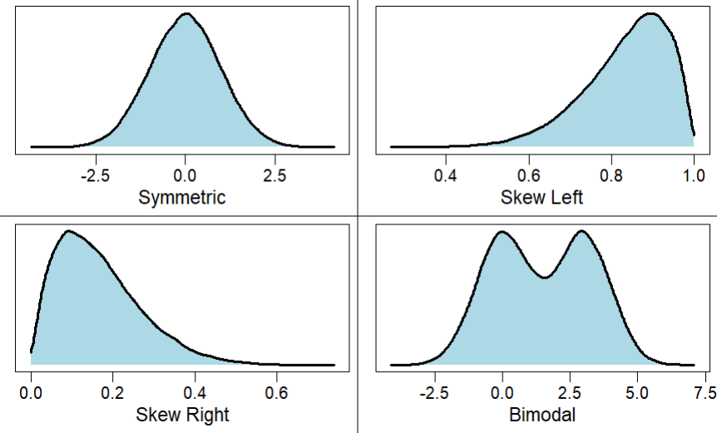
Shape of a distribution

Slide 10
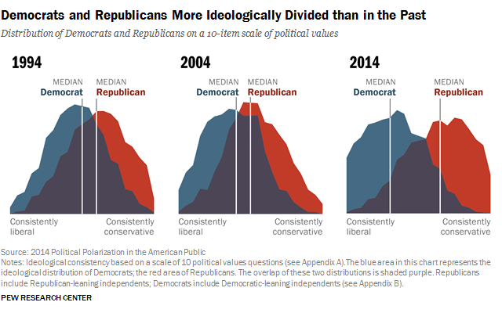
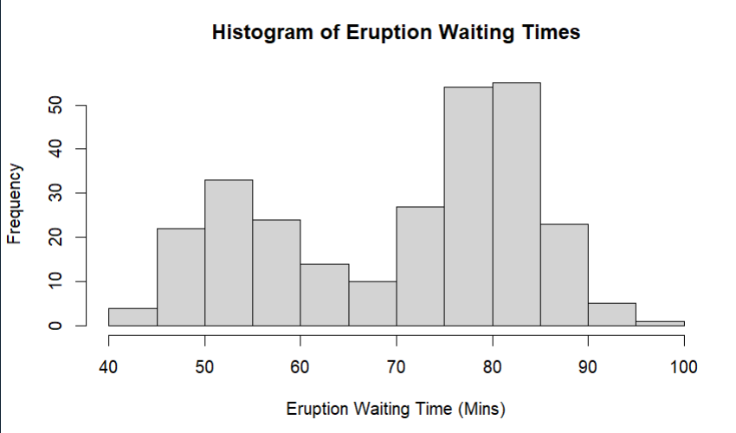
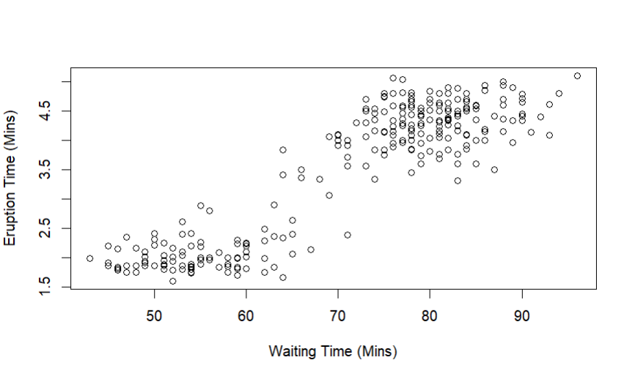
Bimodal distributions can arise when
- A population is polarized on a controversial issue
- When observations come from two different populations

Slide 11
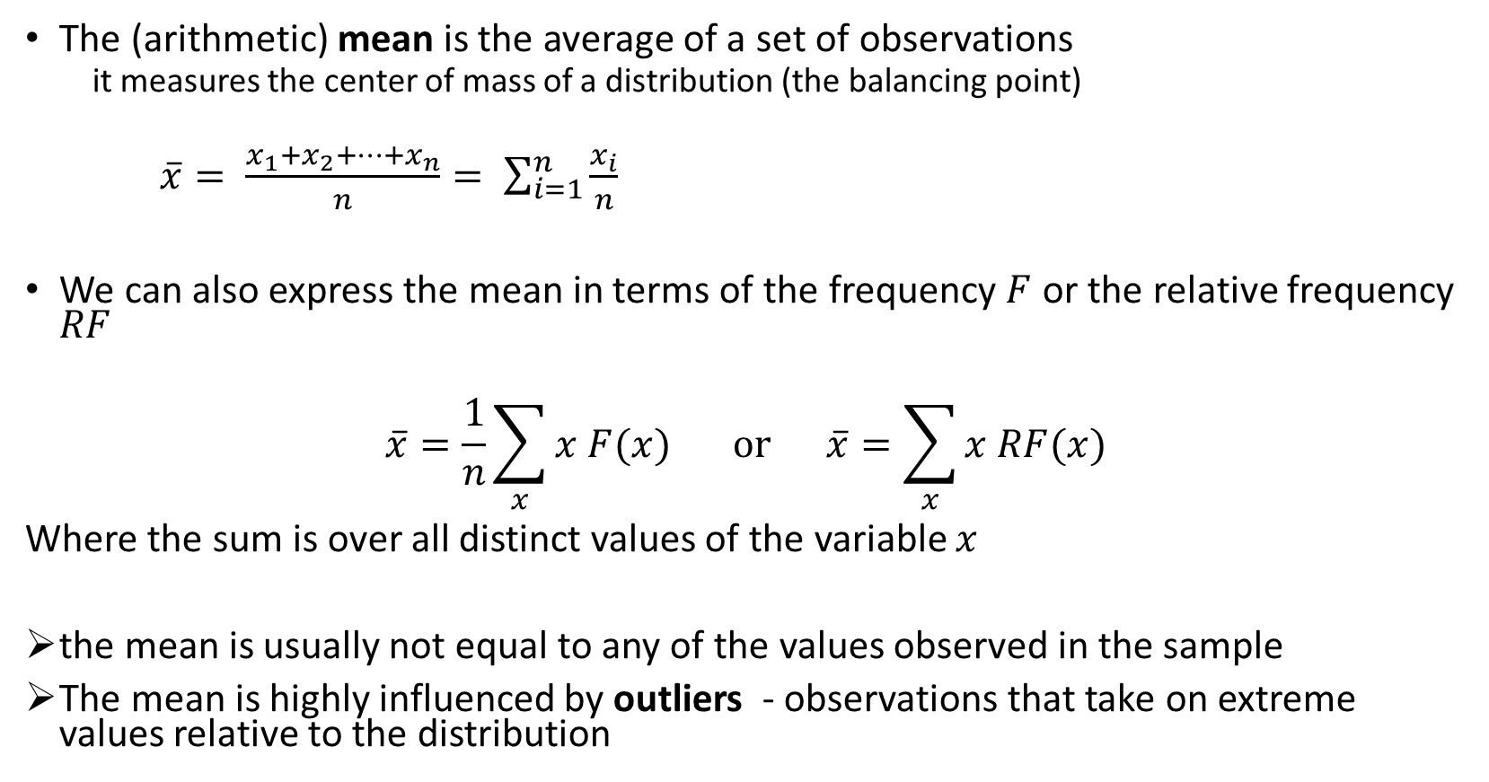
Measures of Central Tendency
The (arithmetic) mean is the average of a set of observations
it measures the center of mass of a distribution (the balancing point)
$\overline{x}= \frac{x_{1}+x_{2}+…+x_{n}}{n}= \sum_{i=1}^{n}{\frac{x_{i}}{n}}$
We can also express the mean in terms of the frequency $F$ or the relative frequency $RF$
$$\overline{x}=\frac{1}{n}\sum_{x}{x F(x)} or \overline{x}=\sum_{x}{x RF(x)}$$
Where the sum is over all distinct values of the variable $x$
the mean is usually not equal to any of the values observed in the sample
The mean is highly influenced by outliers - observations that take on extreme values relative to the distribution

Slide 12
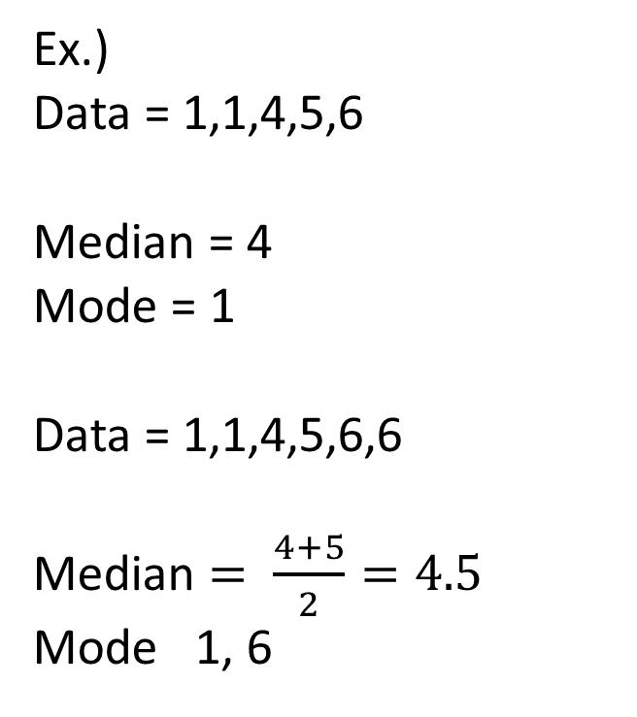
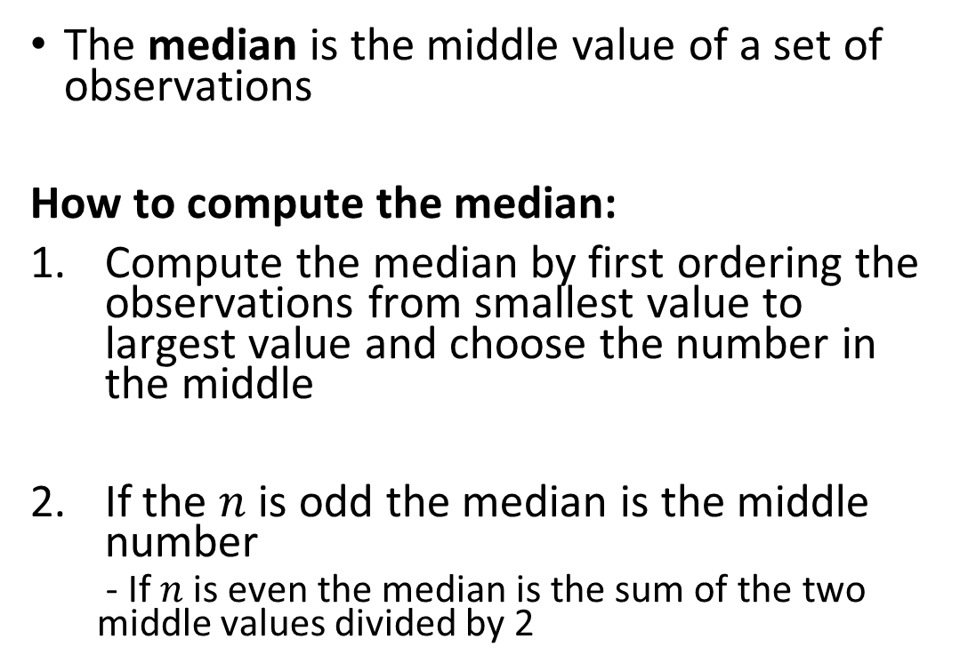
Measures of Central Tendency
The median is the middle value of a set of observations
How to compute the median:
Compute the median by first ordering the observations from smallest value to largest value and choose the number in the middle
If the $n$ is odd the median is the middle number
- If $n$ is even the median is the sum of the two middle values divided by 2
Ex.)
Data = 1,1,4,5,6
Median = 4
Mode = 1
Data = 1,1,4,5,6,6
Median $= \frac{4+5}{2}=4.5$
Mode 1, 6

Slide 13
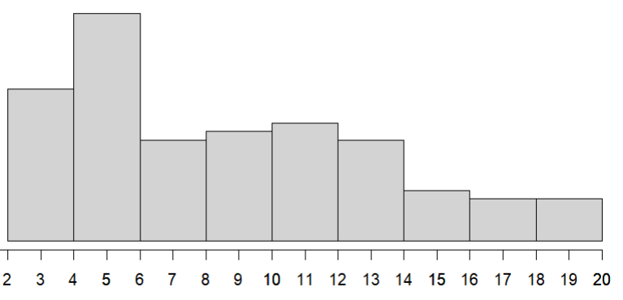


Data: 3 3 3 3 3 3 3 4 4 4 4 4 4 4 4 4 4 5 5 5 5 5 5 5 5 5 5
5 5 5 5 5 5 5 5 5 6 6 6 6 6 6 6 6 6 6 7 7 7 7 7 7 7 7
7 8 8 8 8 8 8 9 9 9 9 9 9 9 10 10 10 10 10 10 10 11 11 11 11 11 12
12 12 12 12 12 12 12 13 13 13 14 14 14 14 14 14 15 15 15 16 16 16 16 17 17 17 18
18 20 20 20 20 20
$$\overline{x}=9.2$$
$$median=\frac{8+8}{2}=8$$
The mean is the center of gravity
The median is the middle value

Slide 14
Measure of Central Tendency
The mode is the value with the largest relative frequency (i.e the value that occurs most often)
Can be used with categorical data (mean and median cannot)
- e.g the most frequent category
It may not be unique if two or more values have the same frequency
Caution for quantitative data, the mode may not anywhere near the center of the distribution.
Ex.)
Data = 1,1,4,5,6
Mode = 1
Data = 1,1,4,5,6,6
Mode 1, 6

Slide 15
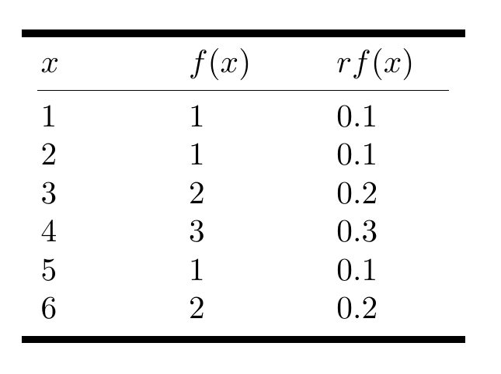
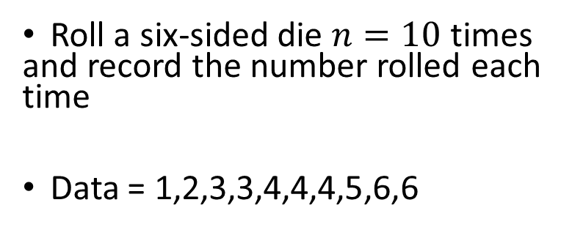
Practice:
Roll a six-sided die $n=10$ times and record the number rolled each time
Data = 1,2,3,3,4,4,4,5,6,6
Compute the mean using all 3 equations:
Compute the median
Compute the mode

Slide 16
Comparing the Mean, Median, and Mode
The shape of a distribution influences whether the mean is larger or smaller.
Skew left = mean < median
Skew right = mean > median
When a distribution is symmetric the mean will equal the median

Slide 17
Comparing the Mean, Median, and Mode
The median is a robust estimate of the mean
The median is not usually affected by the presence of outliers
The median is usually preferred for highly skewed distributions
Ex.) take using the following 9 data points: 0.3, 0.4, 0.8, 1.4, 1.8, 2.1, 5.9, 11.6, 16.9
The mean is about 4.58
The median is 1.8
Change one of the data points to be an outlier, for example, we change 16.9 to 90
The mean becomes 12.7
While the median is still 1.8

Slide 18
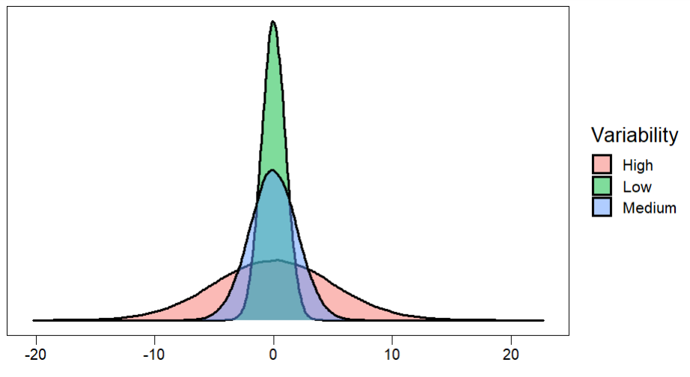
Variability of A Distribution: Measures of Spread

Slide 19
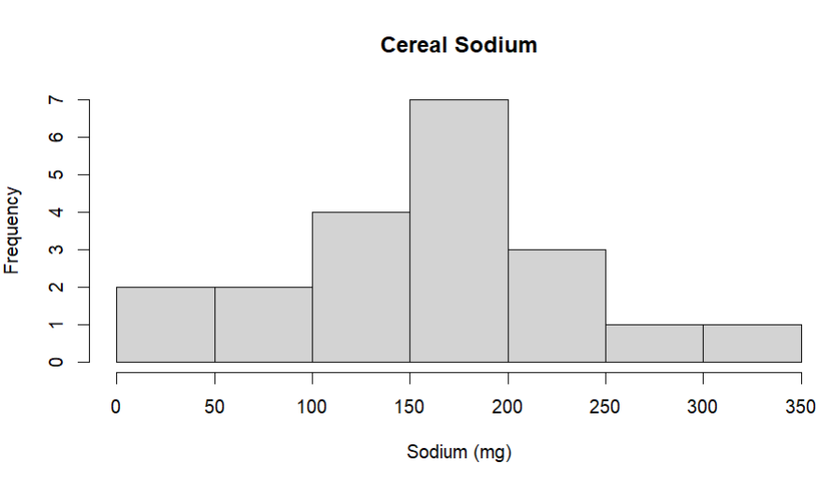
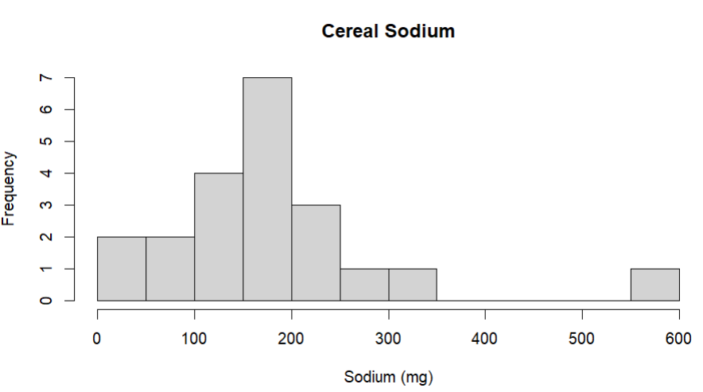
Measures of Spread: Range
The range is a measure of the distance between the smallest and largest values in the data
The range can be computed with only two data points the minimum value and maximum value
If the range of a set of data is large, then the data vary more
The range is severely affected by the presence of outliers
We typically do not use the range to measure variability

Slide 20
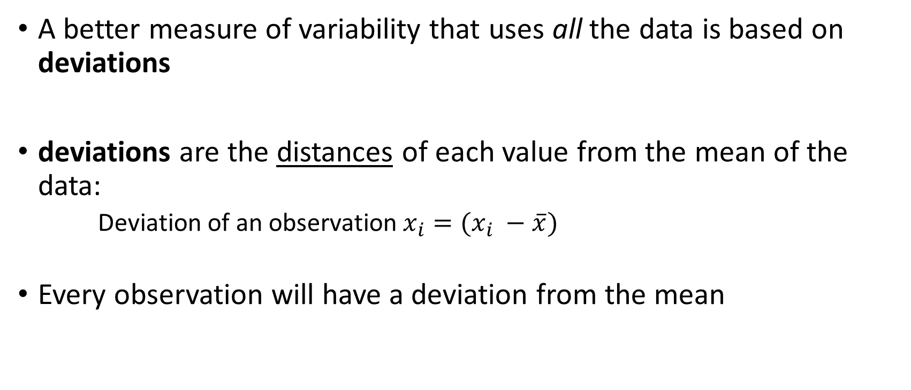
Measures of Spread: Deviation
A better measure of variability that uses all the data is based on deviations
deviations are the distances of each value from the mean of the data:
Deviation of an observation$x_{i}=(x_{i} −\overline{x})$
Every observation will have a deviation from the mean

Slide 21
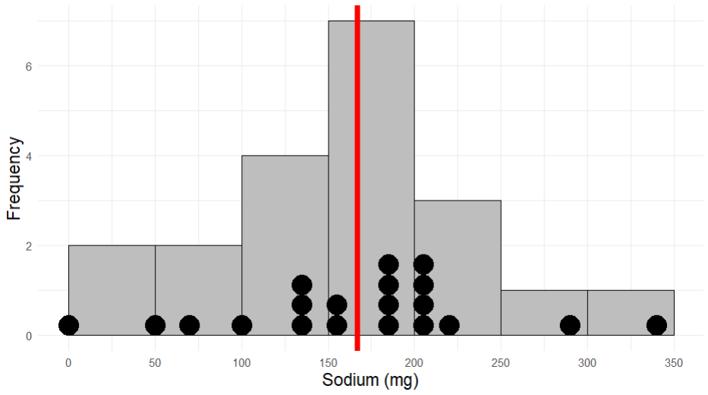


Frosted Mini Wheats = 0 (mg)
Mean = 167 (mg)
Rice Krispes = 340 (mg)
$$0 −167=−167$$
$$340 −167=173$$

Slide 22
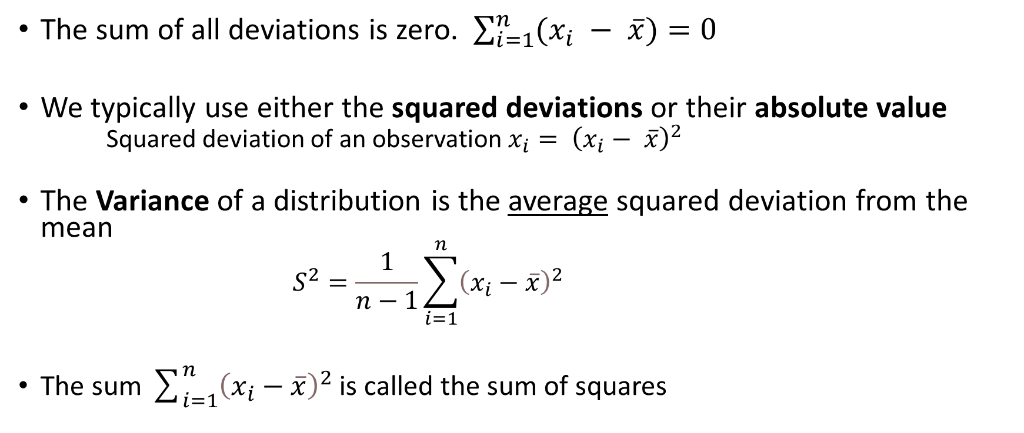
Measures of Spread: Variance
The sum of all deviations is zero. $\sum_{i=1}^{n}{(x_{i} − \overline{x})}=0$
We typically use either the squared deviations or their absolute value
Squared deviation of an observation $x_{i}= {\left(x_{i}− \overline{x}\right)}^{2}$
The Variance of a distribution is the average squared deviation from the mean
$$S^{2}=\frac{1}{n−1}\sum_{i=1}^{n}{{\left(x_{i}−\overline{x}\right)}^{2}}$$
The sum $\sum_{i=1}^{n}{{\left(x_{i}−\overline{x}\right)}^{2}}$ is called the sum of squares

Slide 23
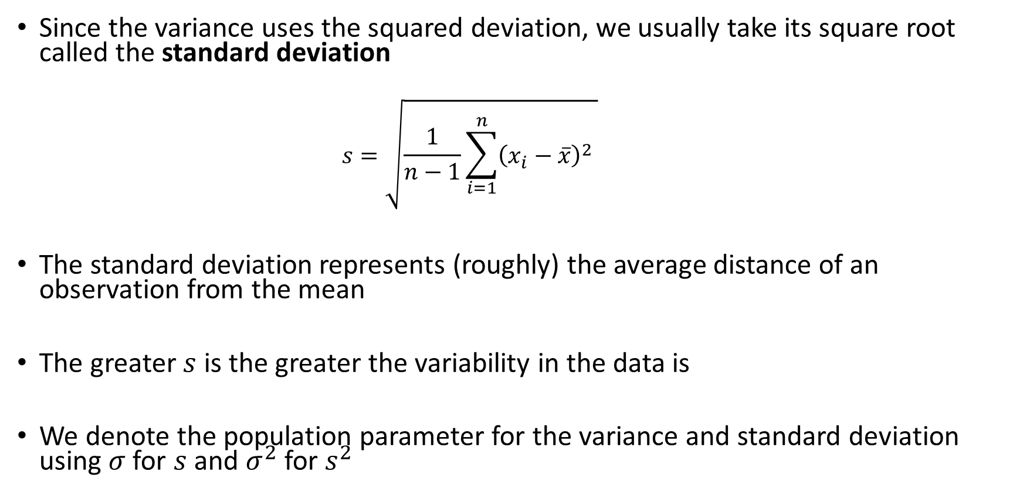
Measures of Spread: Standard Deviation
Since the variance uses the squared deviation, we usually take its square root called the standard deviation
$$s=\sqrt{\frac{1}{n−1}\sum_{i=1}^{n}{{\left(x_{i}−\overline{x}\right)}^{2}} }$$
The standard deviation represents (roughly) the average distance of an observation from the mean
The greater $s$ is the greater the variability in the data is
We denote the population parameter for the variance and standard deviation using $σ$ for $s$ and $σ^{2}$ for $s^{2}$

Slide 24
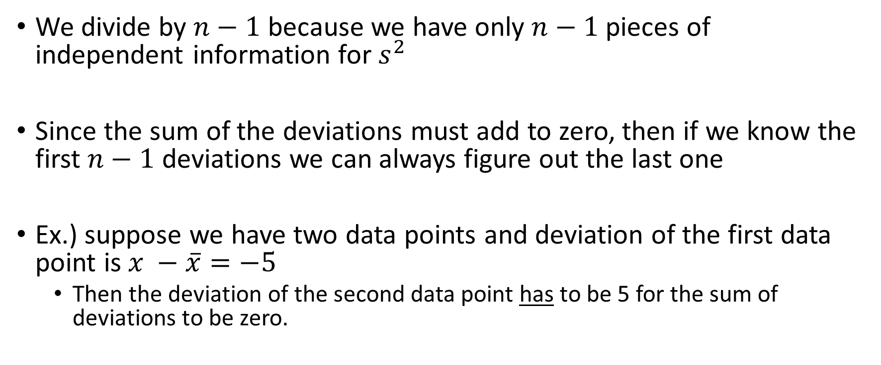

Why divide by $n−1$ ?
We divide by $n−1$ because we have only $n−1$pieces of independent information for $s^{2}$
Since the sum of the deviations must add to zero, then if we know the first $n−1$ deviations we can always figure out the last one
Ex.) suppose we have two data points and deviation of the first data point is $x −\overline{x}=−5$
Then the deviation of the second data point has to be 5 for the sum of deviations to be zero.

Slide 25
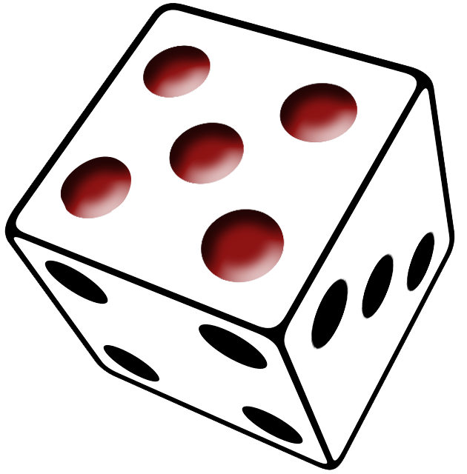

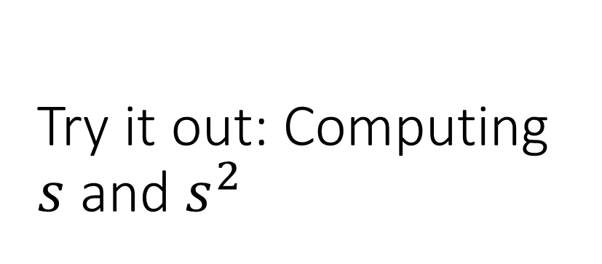
Try it out: Computing $s$ and $s^{2}$
Roll a six-sided die $n=10$ times and record the number rolled each time
Data = 1,2,3,3,4,4,4,5,6,6
Mean = 3.8

